Slide 1

Implementing Cross-Enterprise Document Sharing (XDS) based on Blockchain Technology
Petnathean Julled

Slide 2

Content
Introduction
Related Work
Blockchain
XDS
Proposed Method
Current Status

Slide 3
Introduction
Digital transformation of healthcare industry
Increase quality and efficiency of healthcare service
Health Information Sharing and Interoperability
Scattered patient’s health data
Notes:
On the increasing demand for better quality of healthcare service, there is the topic that involve healthcare information technology in term of operation efficiency.
Patient’s health document data are scattered across different healthcare organizations.
If these scattered information can tie together, it will improve quality and efficiency of healthcare service

Slide 4
Introduction
Problems of Health Information Sharing and Interoperability
Different in development of health information technology
Sharing of information is difficult to achieve.
Health information have unique characteristics
Notes:
What’s the matter?

Slide 5
Health Sharing Example
https://www.himss.org/library/interoperability-case-study-mihin
https://www.himss.org/library/interoperability-case-study-atrium-health

Slide 6
Existing Standard
Integrating Healthcare Enterprise (IHE)
As respond to Health Information Sharing issue and Interoperability, there found initiative to standardize health informatics.
IHE is one of well-known initiative who provide materials for healthcare organization for developing their system to meet requirement in healthcare operation.
Cross-Enterprise Document Sharing (XDS.b) Profile
XDS.b Profile define actors scheme and transaction format that needed for enable health document sharing between different healthcare organizations.
The profile ensure that any organization implement their system following the profile can systemically exchange document and communicate with each other.
However, XDS.b profile have its limits
It require confident amount of trust between each parties to share their information asset with each other
Its security characteristics rely mainly on trust and policy between XDS Affinity Domain members
There are open issue regard security of shared data.
Notes:
What’s the matter? Independent from trust

Slide 7
Emerging Cyber-threats Threatening Healthcare Industry
Amount of cyber-attack and variation rise as the technology developed.
These incidents target integrity and availability of data
It can halt hospital operation for a period of time which
may cost hospital for more than million
Or even cost individuals’ life as a result of the incident for the worst.
Compromised data can be valuable in dark market
it can be further used for various kind of more advanced attacks
due to these data mostly included patients’ personal information and their health condition.
Notes:
What’s the matter?

Slide 8
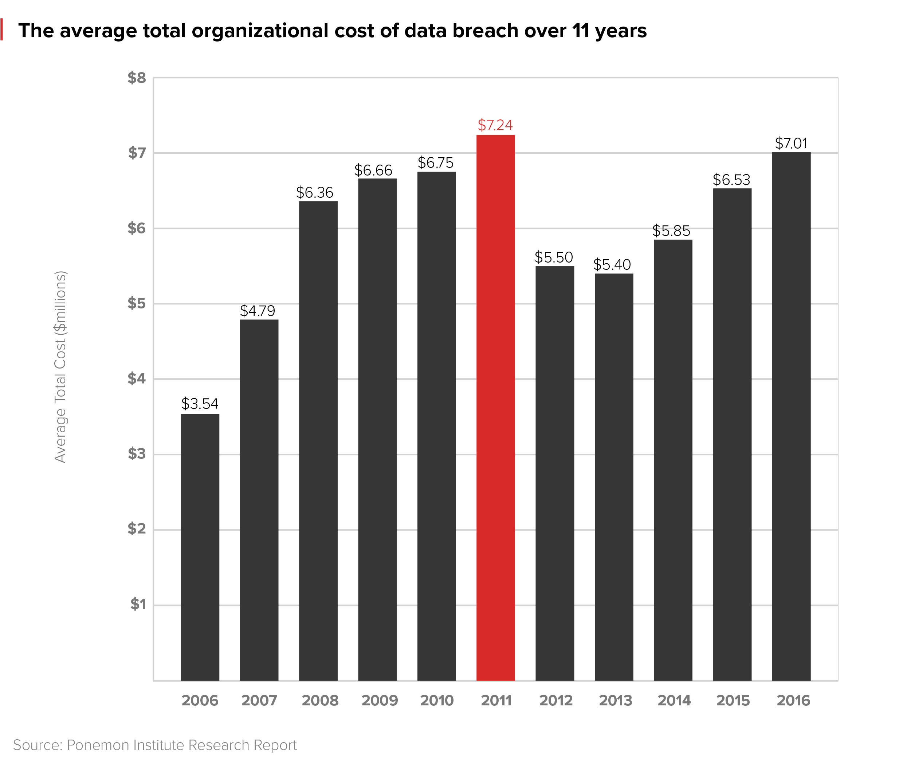
Reference from HealthcareDive.com

Slide 9
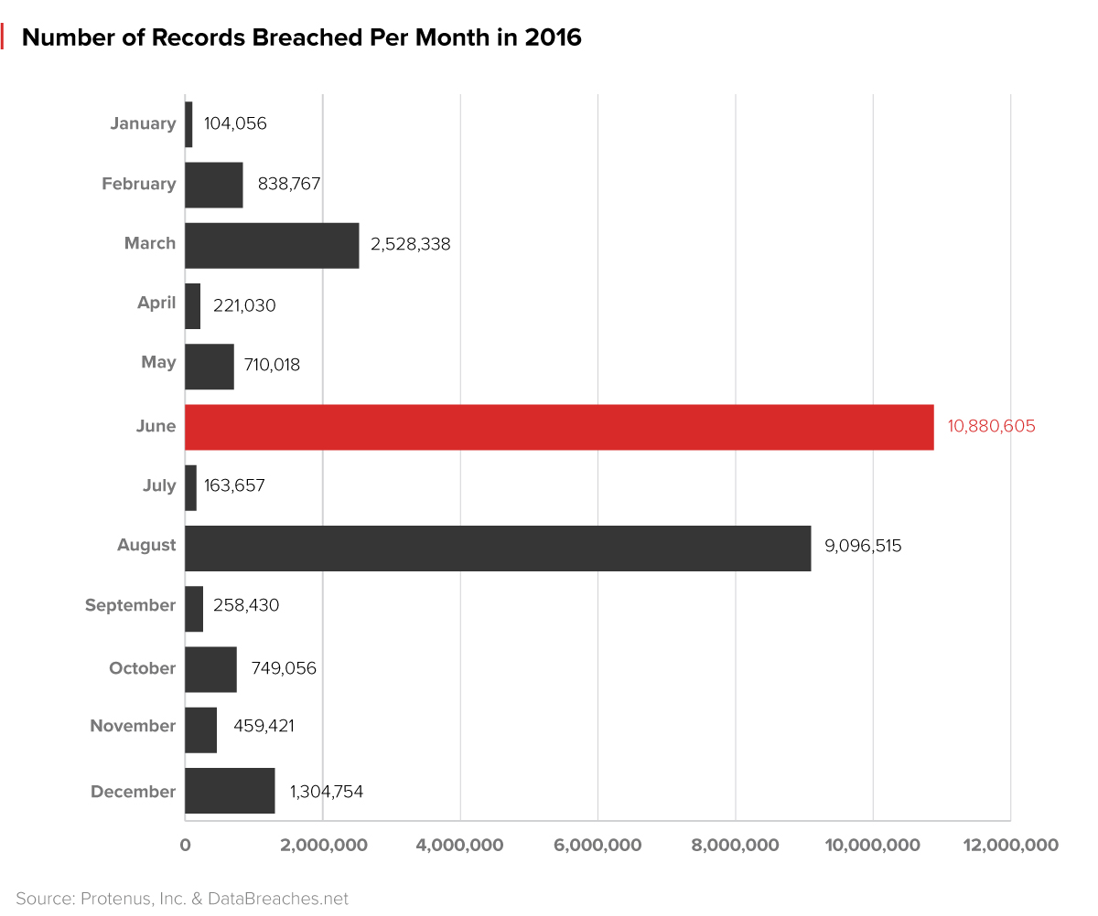
Reference from HealthcareDive.com

Slide 10
Ransomware example
https://www.healthcareitnews.com/news/ransomware-attack-against-california-provider-breaches-data-85000-patients
https://www.healthcareitnews.com/news/update-ransomware-attack-cass-regional-shuts-down-ehr
https://www.healthcareitnews.com/news/ransomware-malware-attack-breaches-45000-patient-records
Notes:
Centralized data can easily become victim to these kinds of cyber-attack. If the data got compromised, other than rely on data backup, there are few options to mitigate the incident.
This also known as single point of failure problem.
Currently, there are trend about decentralize data using Blockchain technology which designed to mitigate single point of failure problem.

Slide 11
Issues
Need of health information sharing between different enterprises
Healthcare information have unique characteristics
‘Trust’ amongst sharing network
Integrity and availability of sharing data
Survival of data after cyber-incidents
Notes:
Reason why need Blockchain come here first

Slide 12
Related Work

Slide 13
A Blockchain-Based Approach to Health Information Exchange Networks
Peterson K, Deeduvanu R, Kanjamala P, Boles K. A Blockchain-Based Approach to Health Information Exchange Networks. Mayo Clin [Internet]. 2016;10. Available from: http://www.colleaga.org/sites/default/files/12-55-blockchain-based-approach-final.pdf
Blockchain that allow healthcare information sharing and audit trail using FHIR URL as main component
Notes:
How people currently doing it?

Slide 14
A Case Study for Blockchain in Healthcare: “MedRec” prototype for electronic health records and medical research data
Ekblaw A, Azaria A, Halamka JD, Lippman A, Original I, Vieira T. A Case Study for Blockchain in Healthcare: " MedRec " prototype for electronic health records and medical research data. IEEE Technol Soc Mag [Internet]. 2016;1–13. Available from: https://www.healthit.gov/sites/default/files/5-56-onc_blockchainchallenge_mitwhitepaper.pdf
Blockchain that allow healthcare information sharing, patient consent over their own data, and enable Protected Health Information for data analytical research
Notes:
How people currently doing it?

Slide 15
Decentralizing privacy: Using Blockchain to Protect Personal Data
Zyskind G, Nathan O, Pentland AS. Decentralizing privacy: Using Blockchain to Protect Personal Data. Proc - 2015 IEEE Secur Priv Work SPW 2015. 2015;180–4.
The base work for MedRec
Proposing Cryptographic key scheme that allow Blockchain to track health information sharing between healthcare institutions while allow patient to have control over their own data
Notes:
How people currently doing it?

Slide 16
Blockchain-Based Data Preservation System for Medical Data
Li H, Zhu L, Shen M, Gao F, Tao X, Liu S. Blockchain-Based Data Preservation System for Medical Data. J Med Syst. Journal of Medical Systems; 2018;42:1–13.
Regardless of what medical data are being published to Blockchain, this work offer Blockchain platform that help encrypt and ensure integrity of the data.
Notes:
How people currently doing it?

Slide 17
From existing work,
Mostly focus on using distributed characteristic of Blockchain to share health information and provide minor interoperability
Only some of existing work are addressing unique characteristics of health information
Not directly addressed security of data (except the last one)
Not directly addressed issue about ‘trust’ amongst sharing network
None of any existing works addressed health information sharing and its security altogether
Notes:
Refer existing work ไปหา problem ที่รวบไว้ใน introduction ชี้ประเด็นว่างานเราต่างจากของคนอื่น ที่เคยคุยกันไว้

Slide 18
Proposed Work

Slide 19
Implementing Cross-Enterprise Document Sharing (XDS) based on Blockchain Technology
We proposing implement Cross-Enterprise Document Sharing (XDS.b) based on Blockchain Technology
Allow health document sharing between different enterprises
XDS.b was designed specifically for unique characteristics of healthcare information
Solve ‘trust’ issue amongst health document sharing network
Ensure integrity and availability of health document sharing
Increase chance of survival of health document after cyber-incident
Notes:
What’s problem it is? 1+2

Slide 20
Objective
Design and implement Document Registry Blockchain that follow requirement for document registry defined in XDS.b integration profile from IHE.
Design and implement Blockchain smart contract that give main function to Document Registry Blockchain as healthcare document registry.
Design and implement Blockchain smart contract that give additional function to record healthcare document exchange between participate node.
Deploy and evaluate functionality of Document Registry Blockchain.

Slide 21
Scope of Project
Design and implementation of Document Registry Blockchain that followed requirement defined in XDS.b integration profile from IHE.
Design and implementation of Blockchain smart contract within Document Registry Blockchain that give main function as healthcare document registry and additional function as healthcare document exchange history record.

Slide 22
Our contribution
Design Blockchain environment that focus on allow health document sharing between different enterprises through compliance of IHE XDS.b profile
Design software that act as a middle between XDS.b profile process and Blockchain
Design Blockchain smart contract that integrate Blockchain into XDS.b profile process flow
Design search algorithm for document registry published on Blockchain
Propose additional smart contract function as audit trail for exchanged health document

Slide 23
Block Chain

Slide 24
Blockchain
A distributed digital ledgers of cryptographically signed transactions that are grouped into blocks
Blockchain ensure integrity and availability of published data
Published data are distributed and available to all participant ‘node’
No one can ‘own’ the Blockchain network
Types of Blockchain
Public Blockchain
Private Blockchain
Permissioned Blockchain (aka Consortium Blockchain)

Slide 25
Blockchain – Key components
Transaction
All data publish to Blockchain in the form of transaction
Each transaction have its own content depend on its owner and purpose
‘Block’ of transactions
Block is group of transactions which packed together
Block is cryptographically signed and have its unique signature
Transaction being publish in the same Blockchain period are put in the same Block
Cryptographically hashed ‘Chain’
Hash value that tie all Block in the chain together
Hash chain prevent modification of published Block inside Blockchain
Any modification made to just one Block will cause hash value of the entire chain to change
Participant ‘Node’
Any machine participate in the Blockchain network
Represent population of each Blockchain network

Slide 26
Blockchain – Key components
Consensus
Consensus prevent monopoly of Block publishing right
Ensure that there are no one can tamper with data in publishing Block
Ensure that the entire Blockchain network publish the same Block into the Chain
Types of known consensus
Proof of Work: Miner node compete against each other to become the one who publish new block
Proof of Stake: The longer the node participated in the network, the more trust they gained
Practical Byzantine False Tolerance (PBFT): Rely on majority of network to vote for block approval
Raft: Complicate consensus algorithm that priority availability before integrity
Proof of Authority: Similar to PBFT but alter sequence of data distribution to guarantee its availability
Notes:
Should have more detail

Slide 27
Blockchain – Key components
Smart Contract
Initially unique to ‘Ethereum Blockchain’ platform
Enable flexible usage of Blockchain transaction
Allow addition of programming behavior to Blockchain transaction
In Ethereum, the client who call for the smart contract will be the one to execute its program.

Slide 28
Cross-Enterprise Document Sharing (XDS) Profile

Slide 29
XDS.b
Organization that participate in XDS network are called XDS Affinity Domain member
XDS.b provide
Standardized messaging process pattern and message format that allow complied system to communicate with other complied system
Guideline to data structure which should be made available via document sharing that allow interoperability between different enterprises.
Guideline to document sharing system that compatible with common healthcare operations.
XDS.b share health document via document registry
In XDS.b profile, document registry contain set of metadata attributes belong to each document
Users will query for value of specific attributes they known about the document they seek.
It depend on each XDS Document Consumer, to use value specified in some attributes to enforce their organization policy. i.e. access control over data
Notes:
What’s the matter?

Slide 30
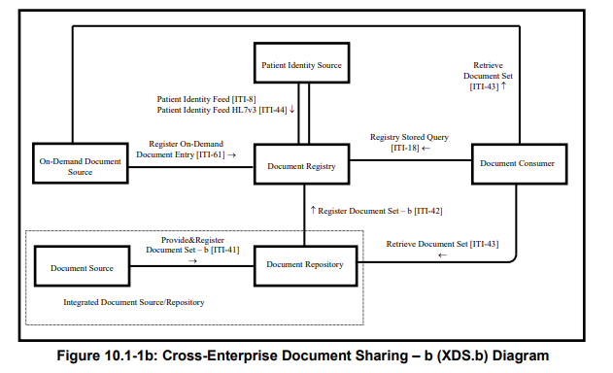
XDS.b Diagram
Notes:
What’s the matter?

Slide 31
Metadata Attributes
Metadata attributes divided into 3 groups
SubmissionSet: Metadata attributes represent submission detail of document
Folder: Metadata attributes represent group of document
DocumentEntry: Metadata attributes represent the document itself

Slide 32
Metadata Attributes - SubmissionSet
SubmissionSet Metadata Attributes | Description
author | The humans and/or machines that authored the SubmissionSet. This attribute contains the sub-attributes: authorInstitution, authorPerson, authorRole, authorSpecialty, authorTelecommunication.
availabilityStatus | The lifecycle status of the SubmissionSet.
comments | Comments associated with the SubmissionSet.
contentTypeCode | The code specifying the type of clinical activity that resulted in placing the associated content in the SubmissionSet.
intendedRecipient | The organizations or persons for whom the SubmissionSet is intended.
patientId | The patientId represents the primary subject of care of the SubmissionSet.
sourceId | Identifier of the entity that contributed the SubmissionSet.
submissionTime | Point in time at the creating entity when the SubmissionSet was created
title | The title of the SubmissionSet.
uniqueId | Globally unique identifier for the SubmissionSet assigned by the creating entity.
… | …

Slide 33
Metadata Attributes – Folder Metadata
Folder Metadata Attributes | Description
availabilityStatus | The lifecycle status of the Folder.
codeList | The set of codes specifying the type of clinical activities that resulted in placing DocumentEntry objects in the Folder.
comments | Comments associated with the Folder.
entryUUID | A globally unique identifier used to manage the entry.
homeCommunityId | A globally unique identifier for a community.
lastUpdateTime | Most recent point in time that the Folder has been modified.
limitedMetadata | A flag that the associated Folder was created using the less rigorous metadata requirements as defined for the Metadata-Limited Document Source.
patientId | The patientId represents the primary subject of care of the Folder.
title | The title of the Folder
uniqueId | Globally unique identifier for the Folder.

Slide 34
Metadata Attributes - DocumentEntry
DocumentEntry Metadata Attributes | Description
classCode | The code specifying the high-level use classification of the document type (e.g., Report, Summary, Images, Treatment Plan, Patient Preferences, Workflow).
creationTime | The time the author created the document.
eventCodeList | This list of codes represents the main clinical acts, such as a colonoscopy or an appendectomy, being documented.
patientId | The patientId represents the subject of care of the document.
practiceSettingCode | The code specifying the clinical specialty where the act that resulted in the document was performed (e.g., Family Practice, Laboratory, Radiology).
repositoryUniqueId | The globally unique identifier of the repository where the document can be accessed.
serviceStartTime | The start time of the service being documented.
serviceStopTime | The stop time of the service being documented.
sourcePatientInfo | This attribute contains demographic information of the source patient to whose medical record this document belongs.
URI | The URI for the document.
… | …
Notes:
You will see that, these meta attributes allow user to find for health document they need, amongst the sharing network

Slide 35
Protected Health Information (PHI)
Health Insurance Portability and Accountability Act
HIPAA’s definition of Protected Health Information (PHI)
Name
Address (all geographic subdivisions smaller than state, including street address, city county, and zip code)
All elements (except years) of dates related to an individual (including birthdate, admission date, discharge date, date of death, and exact age if over 89)
Telephone numbers
Fax number
Email address
Social Security Number
Medical record number
Health plan beneficiary number
Account number
Certificate or license number
Any vehicle or other device serial number
Web URL
Internet Protocol (IP) Address
Finger or voice print
Photographic image - Photographic images are not limited to images of the face.
Any other characteristic that could uniquely identify the individual

Slide 36
Proposed Method
Notes:
This section need separate เนื่องจาก it involve technical stuff that may need focus explanation without confusing with design overview

Slide 37
XDS.b Process Flow
XDS Document Registry
Notes:
Exclude some part of XDS actor to reduce complexity of demonstration and design
Assume that all XDS Affinity Domain Member have the same patient identifier for use in entire network
Exclude On-Demand Repository actor as its different is just some metadata attributes that it cannot provide like stable document. If someone want to adopt Document Registry Blockchain concept, they can adjust element in smart contract for On-demand document.
- Our design will involve around XDS Document Registry actor which converted from traditional database to Blockchain.

Slide 38
Method
Document Registry
Blockchain ledger
Design Overview
Smart Contract
XDS Document Registry
XDS Document Consumer
Registry Query [ITI-18]
Register Document Set-b [ITI-42]
XDS Document Repository or
XDS Integrated Source/Repository
Document Retrieval [ITI-43]
Notes:
When it become like this, how it answer to our scenario
Why not entire actual document when only member can access
When member first joining, should mention what requirement
Use smart contract to truuger evidence

Slide 39
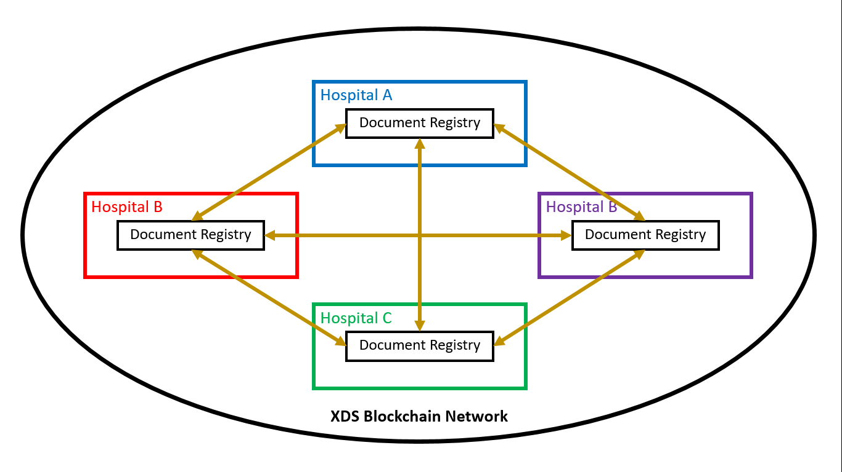
Method
Document Registry of each hospital connected to other as Blockchain network

Slide 40
Method
Allow health document sharing between different enterprises
XDS Document registry Blockchain network
XDS.b was designed specifically for unique characteristics of healthcare information
Blockchain can operate with common XDS system
Solve ‘trust’ issue amongst health document sharing network
Blockchain consensus eliminate requirement for ‘trust’
Ensure integrity and availability of health document sharing
Decentralized Blockchain ledger
Increase chance of survival of health document after cyber-incident
Additional audit trail for shared health documents

Slide 41
Our contribution
Design Blockchain environment that focus on allow health document sharing between different enterprises through compliance of IHE XDS.b profile
Design software that act as a middle between XDS.b profile process and Blockchain
Design Blockchain smart contract that integrate Blockchain into XDS.b profile process flow
Design search algorithm for document registry published on Blockchain
Propose additional smart contract function as audit trail for exchanged health document

Slide 42
Method – Blockchain design for implementation
Design of XDS Blockchain
Permissioned/Consortium Blockchain: Only identity that have right to participate in XDS network will be able to participate in XDS Blockchain
Blockchain node will host by organization that is XDS Affinity Domain member
Each XDS Affinity Domain member will have at least one XDS Document Registry Node which keep full chain and participate as validator node

Slide 43
Method – Blockchain platform
Consider Blockchain platform for implementation
Chose Ethereum,
the main platform that appreciate usage of smartcontract and designed for smartcontract
Supported by large developer community
Opensource
Smart contract
Smart contract allow flexible usage of Blockchain technology
Smart contract allow developer to publish, literally, everything depend on its design
This made implementation of XDS.b with Blockchain, possible

Slide 44
Method - Select consensus for XDS Blockchain
For XDS Blockchain, we chose PBFT
Most suitable with permissioned Blockchain with less than 30 participant nodes
Priority on securing integrity of data publish to Blockchain
PBFT refer to consensus method using with traditional decentralized database, it did not really made for Blockchain
There are Blockchain version of PBFT consensus called Istanbul Byzantine False Tolerance (IBFT)
IBFT is practically PBFT with modified element suitable with Blockchain.
With Blockchain consensus, no one can compromise the entire Blockchain network

Slide 45
Our contribution
Design Blockchain environment that focus on allow health document sharing between different enterprises through compliance of IHE XDS.b profile
Design software that act as a middle between XDS.b profile process and Blockchain
Design Blockchain smart contract that integrate Blockchain into XDS.b profile process flow
Design search algorithm for document registry published on Blockchain
Propose additional smart contract function as audit trail for exchanged health document

Slide 46
Method
XDS Document Registry actor must have capabilities to handle metadata attributes sent within XDS transactions.
In our work, software that act as XDS Document Registry actor must prepare metadata attributes retrieved from transaction and include it into smart contract
XDS Document Registry
XDS Transaction
Programming object
Smart Contract

Slide 47
Method – Encrypt Protected Health Information (PHI)
The XDS attribute called ‘sourcePatientInfo’ must not be revealed to public
As safeguard, this attribute must be encrypted before being published to Blockchain
Purpose of encryption is to prevent the case that copy of Blockchain ledger have leaked outside XDS Affinity Domain, so outsider can not take advantage by abuse content of ‘sourcePatientInfo’ attribute

Slide 48
Method
XDS Document Registry
Register Document Set-b [ITI-42]
javascript object
Smart Contract
Encrypt ‘sourcePatientInfo’

Slide 49
Our contribution
Design Blockchain environment that focus on allow health document sharing between different enterprises through compliance of IHE XDS.b profile
Design software that act as a middle between XDS.b profile process and Blockchain
Design Blockchain smart contract that integrate Blockchain into XDS.b profile process flow
Design search algorithm for document registry published on Blockchain
Propose additional smart contract function as audit trail for exchanged health document

Slide 50
Method
Document Registry Smart Contract
Solidity pragma x.x.x
Function searchRespond() {
if(author ==‘John Doe’){ return true;} if(patientId==‘123456789’) { return true;} var serviceStartTime = ‘12/12/2017 9:00 AM’;
var serviceStopTime = ‘12/12/2017 10:00 AM’;
}
Function XDSConsumerRespondMessage() { var msg = ‘ <xml>…</xml>’;
}
1st Part
Search responder
2nd Part
Message for XDS Document Consumer
Notes:
Smart contract will have 2 main parts
1st part contain document metadata attributes to be discovered by search function.
2nd part contain XML formatted message read for XDS Document Consumer actor.
The main purpose of this smart contract is to act as document registry
It need to be discoverable by search function using metadata attributes specified by user
It have XML message ready for XDS Document Consumer, which will use value specified within metadata attributes to access actual document.

Slide 51
Our contribution
Design Blockchain environment that focus on allow health document sharing between different enterprises through compliance of IHE XDS.b profile
Design software that act as a middle between XDS.b profile process and Blockchain
Design Blockchain smart contract that integrate Blockchain into XDS.b profile process flow
Design search algorithm for document registry published on Blockchain
Propose additional smart contract function as audit trail for exchanged health document

Slide 52
Method – Transaction search
Related work – Blockchain Transactions Discovery (Search)
Ethereum Query Language
Bragagnolo S, Rocha H, Denker M, Ducasse S. Ethereum query language. 2018 IEEE/ACM 1st Int Work Emerg Trends Softw Eng Blockchain. ACM; 2018;1–8.
To discover transactions within Ethereum Blockchain, use its unique address to call
We can adopt sequential search method for first time search
Then use off-chain application to remember contract eth address for faster access on next time.
Query Support for Data Processing and Analysis on Ethereum Blockchain
Pratama FA, Mutijarsa K. Query Support for Data Processing and Analysis on Ethereum Blockchain. 2019;1–5.
With current state of Blockchain technology, it may need off-chain storage to effectively handle stuff from Blockchain instead of Smartcontract itself.

Slide 53
Search Document Registry Entry
Transaction 0x000001
Input search index
Transaction 0x000001
Patient Name:
‘John Doe’
Patient ID: ‘abc123’ Visit Time:
‘20 Oct 2018’
Patient Name:
‘****’
Patient ID: ‘****’ Visit Time:
‘15 July 2018’
Patient Name:
‘Alice Wonderland’
Patient ID: ‘jkl654’ Visit Time:
‘15 July 2018’
Decrypt

Slide 54
Search Document Registry Entry
Transaction 0x000001
Transaction 0x000005
Transaction 0x000002
Transaction 0x000003
Input search index
Transaction 0x000004
Patient Name:
‘John Doe’
Patient ID: ‘abc123’ Visit Time:
‘20 Oct 2018’
Patient Name:
‘Alice Wonderland’
Patient ID: ‘jkl654’ Visit Time:
‘15 July 2018’
Patient Name:
‘John Doe’
Patient ID: ‘abc123’ Visit Time:
20 Oct 2018’
Case: Emergency
Patient Name:
‘James Bond’
Patient ID: ‘rty852’ Visit Time:
’20 Oct 2018’
Patient Name:
‘John Doe’
Patient ID: ‘abc123’ Visit Time:
’14 May 2017’
Patient Name:
‘John Doe’
Patient ID: ‘abc123’ Visit Time:
’20 Oct 2018’
False
True
False
True
True
False
True
False
True
True
False
True
True
False
True
???
Mismatch
Match
Mismatch
Mismatch
Match
Found list:
Transaction 0x000004
Transaction 0x000005

Slide 55
Our contribution
Design Blockchain environment that focus on allow health document sharing between different enterprises through compliance of IHE XDS.b profile
Design software that act as a middle between XDS.b profile process and Blockchain
Design Blockchain smart contract that integrate Blockchain into XDS.b profile process flow
Design search algorithm for document registry published on Blockchain
Propose additional smart contract function as audit trail for exchanged health document

Slide 56
Method – Document Retrieval Audit on Blockchain
Record activity of document retrieval into Blockchain which enable audit trail for health document tracking
Allow substitution of document after cyber-incidents.
May adopt similar pattern of smart contract for document registry
Notes:
URI is the one XDS Document Consumer will seek for, why not use it to record activity.

Slide 57
Current Status

Slide 58
Current Status
Implemented task
Retrieved Register Document Set-b [ITI-42] transaction sample from XDS Toolkit
Able to receive transaction sent from XDS Toolkit or other sender via TCP
Able to parse ITI-42 transaction and convert it to javascript object
Ethereum Blockchain node ready for smart contract deployment and test

Slide 59
Current Status
Pending task
Arrange document metadata attributes retrieved from Register Document Set-b transaction, for simpler smart contract coding
Create respond message for ITI-42 from created javascript object
Smart contract coding, deployment, and test
Coding of smart contract search function
Receive, parse, and respond Registry Query transaction [ITI-18] transaction

Slide 60

Picture from choice-dental.com

Slide 61



Method
Design Overview
XDS Blockchain
Registry Query [ITI-18]
Search
Smart Contract
Interpreter
Add
Responder
Query Result
Read
Ethereum Blockchain Ledger
Interpreter & Simplifier
Register Document Set-b [ITI-42]

